Slide 1
Time-FED
A Machine Learning System for Time Series Forecasting, Evaluation, and Deployment
James Montgomery
Machine Learning and Instrument Autonomy group, 398J LRR067503
Special thanks:
Umaa Rebbapragada, 398J
Rishi Verma, 398F
Sabino Piazzolla, 337E
Data Science Working Group (DSWG)
Notes:
Hello everyone, I am James Montgomery from the Machine Learning and Instrument Autonomy group 398J. To give a short introduction, I work as an ML engineer which specializes in the design and implementation for both research and deployment of ML services and tools. I have worked on a number of projects that sought to create a generalized system to apply to many different use cases. Time-FED is one of those systems that’s been developed over the past two years to tackle the very large domain that is timeseries.
*Briefly mention what we’re looking for: New collaborators and infusion opportunities

Slide 2
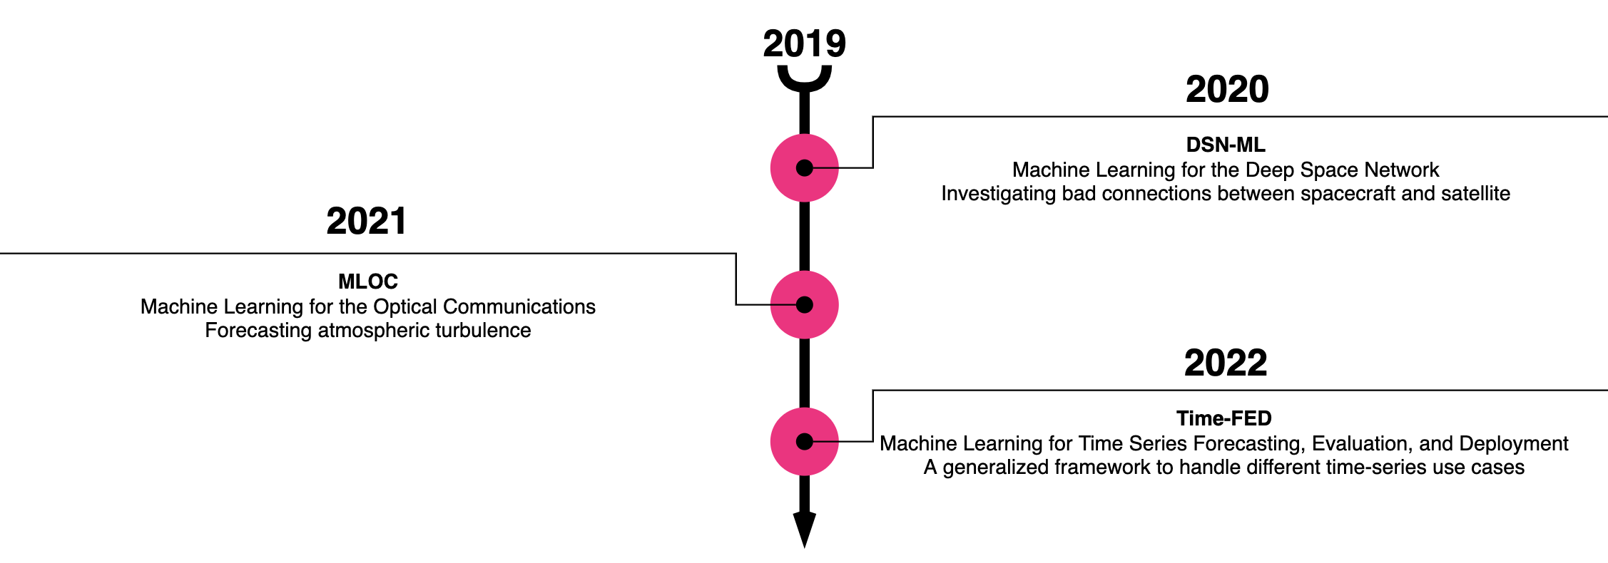
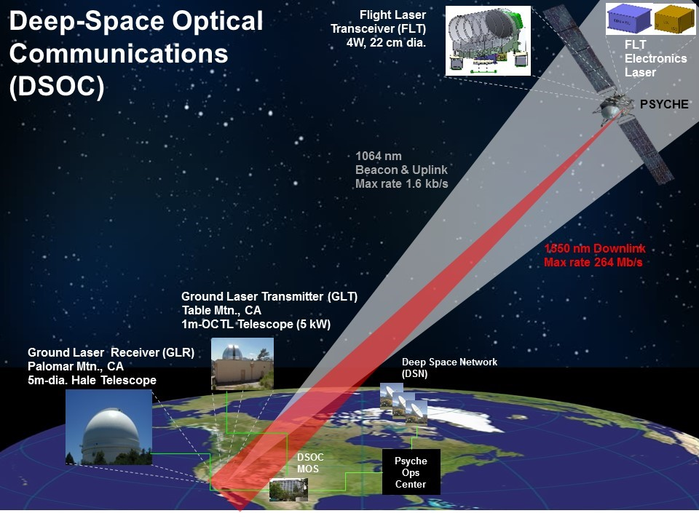
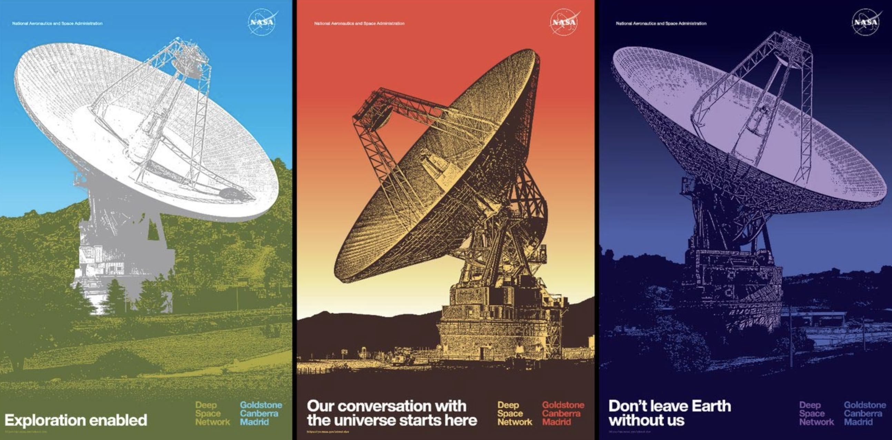
History
Notes:
To give a brief history, Time-FED was born out of a need to do timeseries forecasting on two different, yet similar, datasets. It initially began as a module under a project working for the Deep Space Network (or DSN) back in 2020. The module had promise but due to a lack of funding the project did not move forward with the technology at the time. Eventually a new collaborator came along from the DSOC group in 2021 that wanted to apply ML forecasting to their data. Seeing an opportunity to take that old module and apply it to a new use case lead to the creation of a full system that we now have named Time-FED. These two datasets, DSN and DSOC, had similar needs in forecasting, but presented different input kinds: the former was multivariate, multi-stream input and the latter was multivariate single-stream input. These are two common kinds of timeseries data that we needed a single system to be able to handle. The next few slides will go into detail about why we created this system to respond to these datasets.

Slide 3
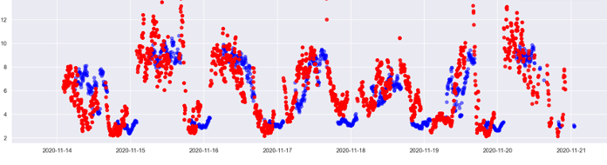
The Challenges
Time-series data is a large domain with a lot of problems for ML:
Inconsistent sampling
How to model temporal aspects of the data
Multi track vs single track input data
Notes:
One of the most challenging steps for data science is data preparation. This is because data often has unique challenges that must be resolved before we can apply an ML algorithm. For the datasets that TimeFED is handling, the largest challenge was that the data is inconsistently sampled. Some variables may sample at different rates; some instruments may produce intermittent reports; the data has been prefiltered; amongst other reasons. Due to these issues, the ability to extract temporally-related information from the data may be limited. Time-FED attempts to address these issues using generizable techniques in hopes to be applicable to different and new datasets.

Slide 4
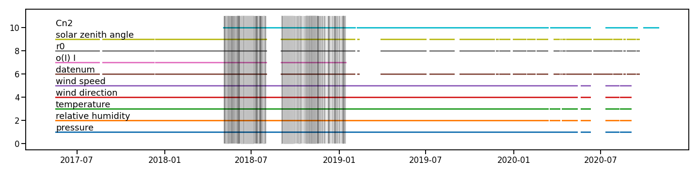
Sparsity
Background
Data is full of inconsistent gaps between variables
Timeseries analysis is difficult to perform due to the significant sparsity
Regions of Full Density
Notes:
The inconsistent sampling problem is what we call sparsity. This was the largest problem for Time-FED to tackle as the datasets we were originally given was very sparse. Take this graph for instance: the bottom five variables are all weather variables, and a few science variables are included such as SZA and r0. The meaning of these variables is irrelevant, but notice the vertical grey bars in the centre of the graph. These are the timestamps, or samples, that are considered “fully dense,” as in there is a value for every variable for this sample. As you can see, the number of fully dense samples is very limited. Even if you disregard some variables such as Cn2 and o(I)/I, and while you can’t see it exactly in this graph, the other variables would not produce many more fully dense samples.

Slide 5
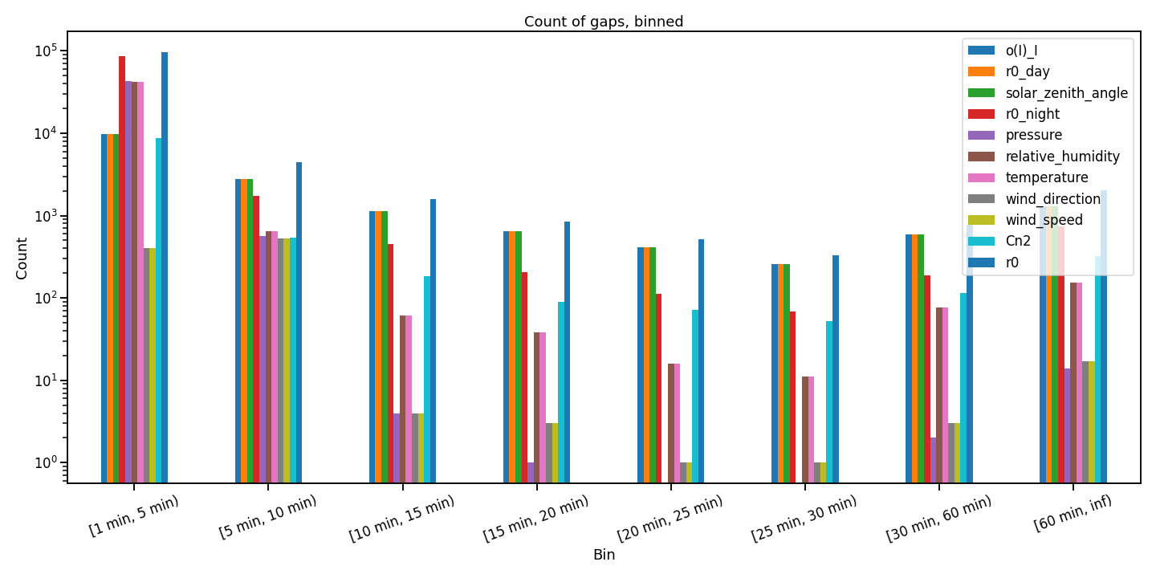
Bad Interpolation
Notes:
This is further highlighted by this histogram which shows the sizes of the gaps for each variable. There are a significant number of gaps that range of 60 minutes or more in length. When our data is expected to sample every minute, having a gap of an hour or more makes techniques such as interpolation unviable. After all, interpolation would lead to the creation of fake data which is a problem we would rather avoid altogether. So, what would be the solution?

Slide 6
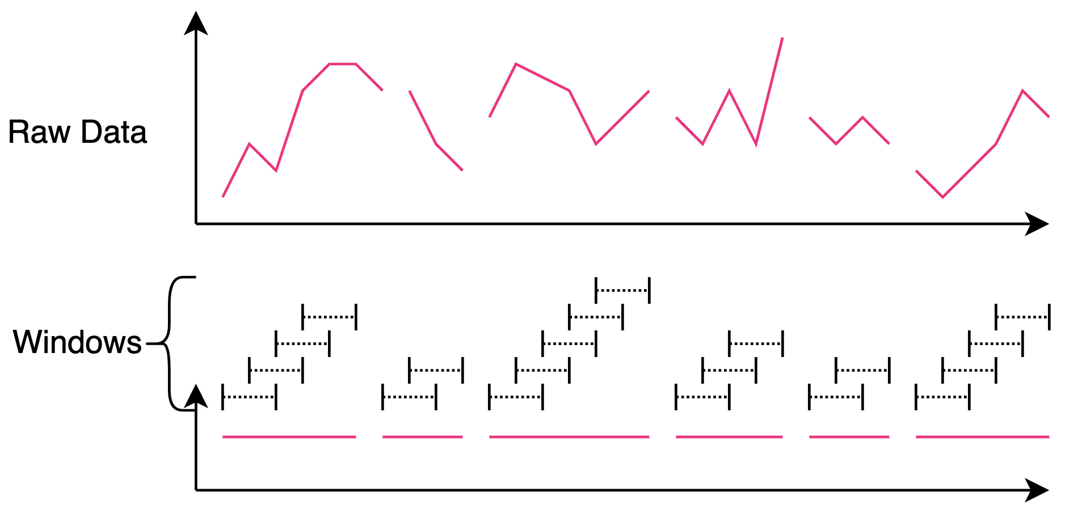
Binned Featurization
Bin the data using windows of time
A window of data is valid if it is fully dense across a minimum subset of variables
Notes:
Well, Time-FED has implemented the technique of binned-featurization. This kills two birds with one stone: we need to work around the gaps in the sparse dataset, and we want to extract more temporal information (or features) from the data, leveraging the fact that it is time series data. The idea here is that we take a window of time, or a subset of the data, to do further processing on. This graphic highlights what’s happening: the input raw data has a few gaps along the way. If you were to visualize reducing this arbitrary variable data down to a flat line, as seen in the lower plot, then we can imagine where we can extract these windows of data. The first part of the variable is dense enough to extract four windows, then there’s a gap, then two more windows, gap, four more, gap, so on and so forth. We extract as many of these windows as we can, and we take into consideration other variables and various configuration options, and we’re left with some amount of windows to do processing on. This leads into the next step: applying featurization using tsfresh.
This leads us to a package called TSFresh., such as wavelet coefficients, fourier transformations, and basic statistics such as min, max, stddev, etc. The idea here is that we take a “window” of data (also defined as a subset of data), pass it through TSFresh to get new features, and at the same time the window is condensed down to one output sample.

Slide 7
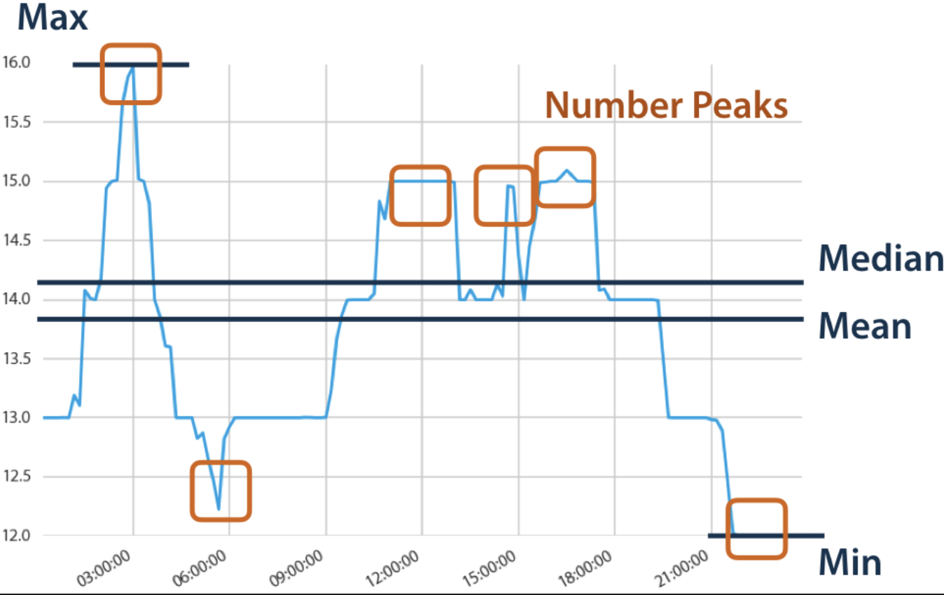
tsfresh
Windows of (M samples, N variables) → (1 sample, N x F) where F = # of feature calculations
Possible Features:
Fourier Transform
Continuous Wavelet Coeffs
Entropy functions
Energy functions
Linear trends
Basic stats
Various ratio functions
And many more
Notes:
TSFresh is a timeseries package that comes with hundreds of functions to extract new features from an input timeseries stream. As mentioned in the previous slide, we extract as many windows of M samples by N variables as we can from the raw data, pass this window in tsfresh, and retrieve an output of 1 sample by N variables times F, which is the number of features calculated. TSFresh offers hundreds of features, and a few can be seen in this graphic. Imagine this plot is one window of our data. TSFresh would return us new features such as the max, min, median, mean, number of peaks, and many more. This is done on each window for thousands of windows.

Slide 8
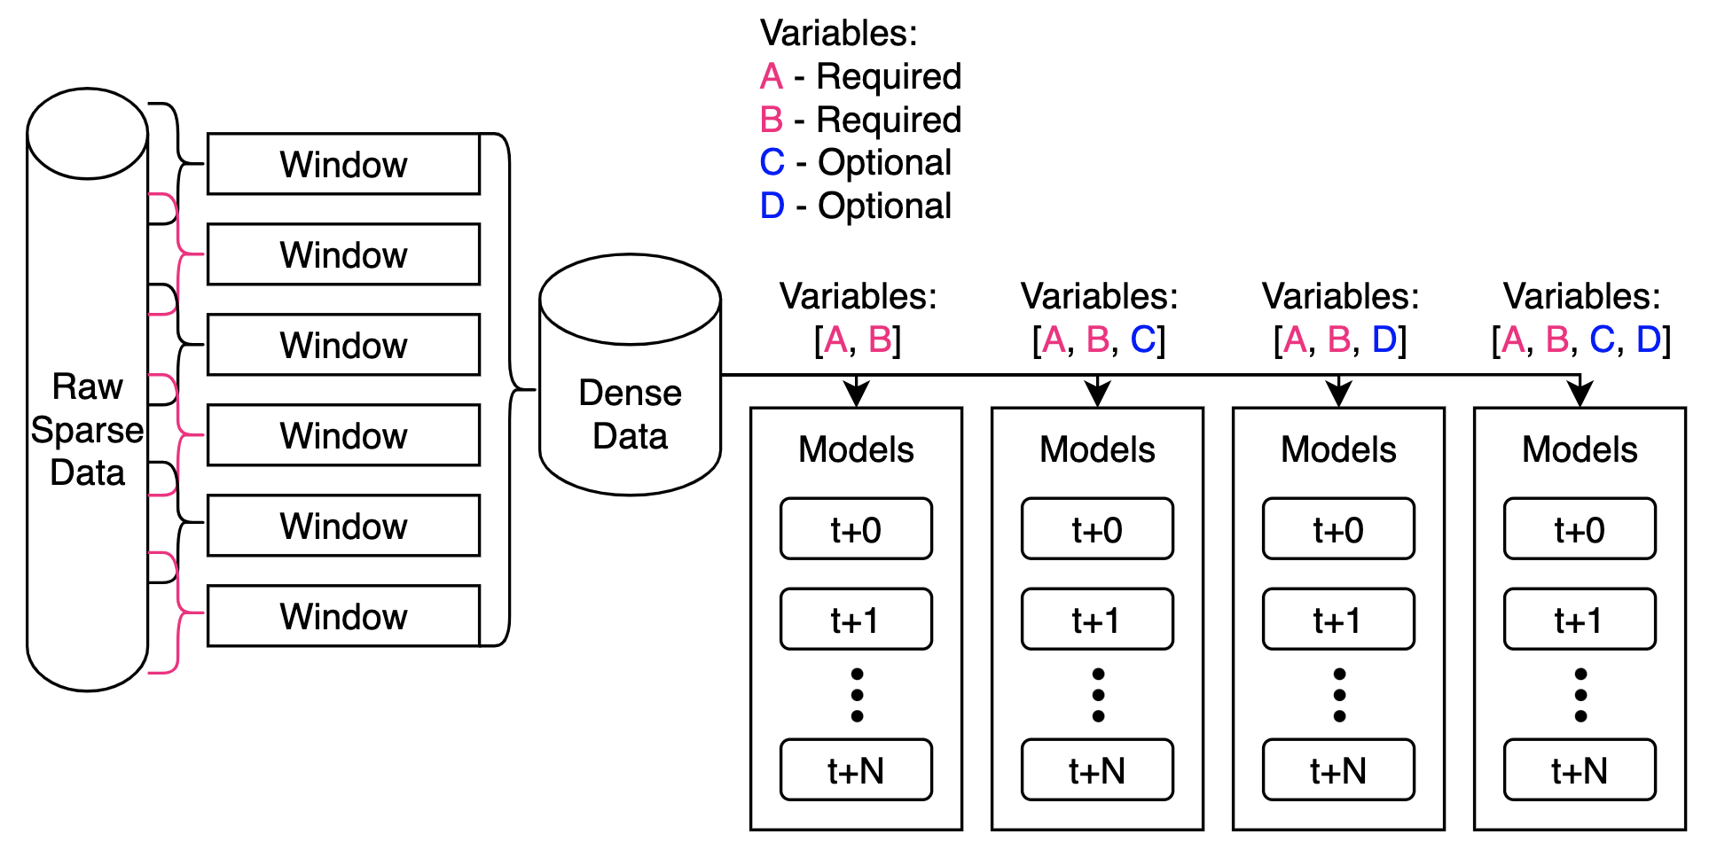
Forecasting
With a fully dense dataset:
Train sets of models on different combinations of variables
Train a model for every forecasting step from now to N time in the future
t = Now, t+0 = Nowcast
DSOC forecasted every 5 minutes up to 3 hours = 36 models per set
Notes:
All of this preprocessing work leads into the ability to create sets of models. Time-FED is designed to be able to handle sparse data, but also missing variables altogether. We can create sets of models that include only a subset of variables. Of course, this comes with performance hits depending on which variables are present, but enables the ability to always be forecasting, possibly even improving forecasts over time as variables become available again. Not only do we create model sets for different variable combinations, but we also create models for different forecasting steps. For the DSOC case, we forecasted every 5 minutes up to 3 hours, which gave us a set of 36 models. So, with a large set size, and multiple combinations of available variables, we’re pushing hundreds of models out and are constantly loading and unloading them into memory to respond to the incoming data.

Slide 9
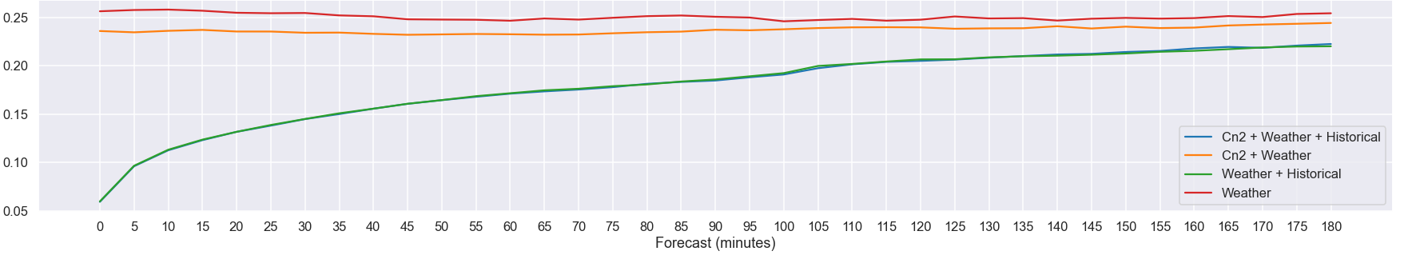
Results
Different sets of models
Error Percentage
Goal: Under 20% error
Achieved up to 110 minutes
Under 25% up to 180 minutes
Notes:
After all of those previous steps and having trained a set of models that can forecast every 5 minutes into the future up to 3 hours, we’ve arrived to favourable results. Our sponsors at the time had a tolerance of 20% error, and as you can see the top plot shows we met that for the first 110 minutes of forecasting when we had all variables available.

Slide 10
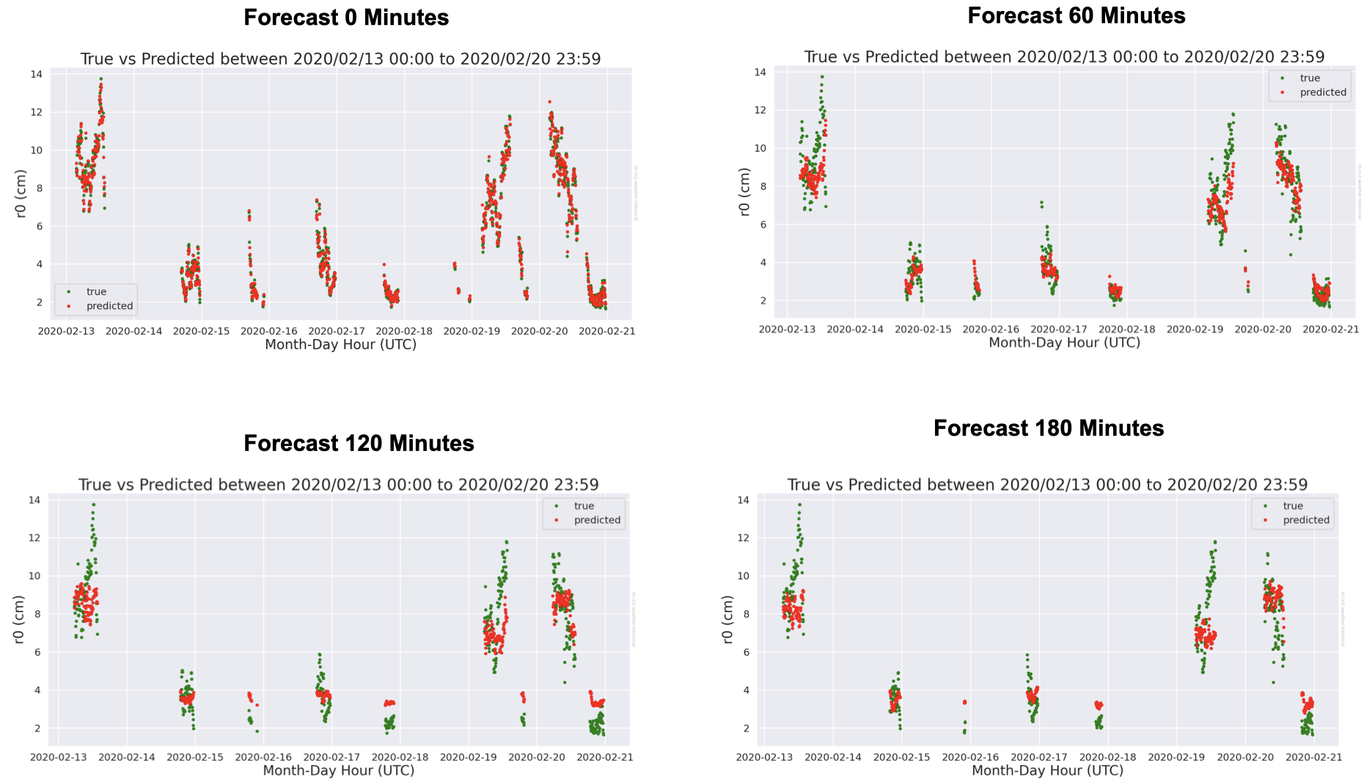

Slide 11
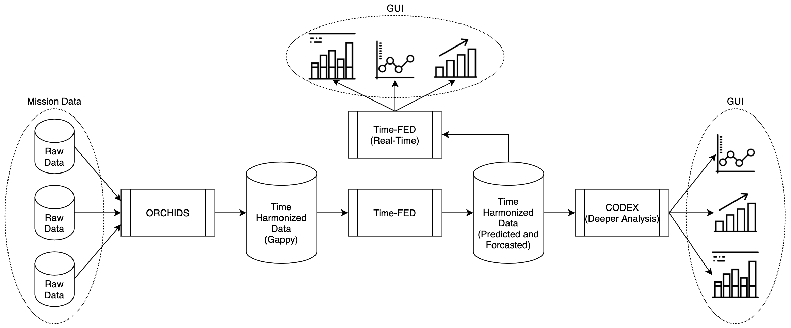
Infusion
Notes:
One of the hopes for Time-FED is that it gains new opportunities for infusion. For example, this is one of the infusion plans we’ve developed that leans on two other technologies being developed currently: ORCHIDS and CODEX. ORCHIDS is a data-harmonizer tool that ingests mission data to output a time-harmonized dataset.

Slide 12
Summary
Time-FED can:
Handle sparse timeseries datasets
Extract temporal information from subsets of data
Produce ML models trained on this extracted data
Apply the models in a real-time environment for forecasting
We are seeking:
New infusion and use-case opportunities
New ideas on how to work with timeseries data
New collaborators interested in forecasting software developed by JPL
Please contact:
James Montgomery (398J) – J.Montgomery@jpl.nasa.gov
Umaa Rebbapragada (398J) – Umaa.D.Rebbapragada@jpl.nasa.gov
Notes:
In conclusion, Time-FED was developed to tackle the sparsity issue in timeseries datasets. It has a variety of strengths including the ability to extract extra temporal information, produce ML models, and provide a real-time interface for forecasting.

